Slide 1
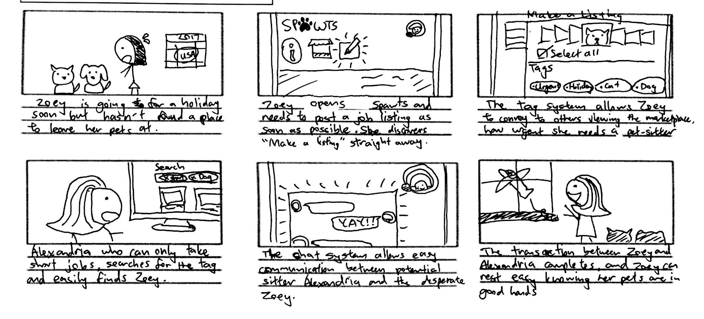
Storyboard: Quick listing of a job

